Slide 1

Gait Detection
Capstone Project Phase A
25-1-R-7
Supervisor: Dr. Julia Sheidin and Dr. Avital Shulner
Presented by: Lital Leschinsky and Maayan Elfassy

Slide 2
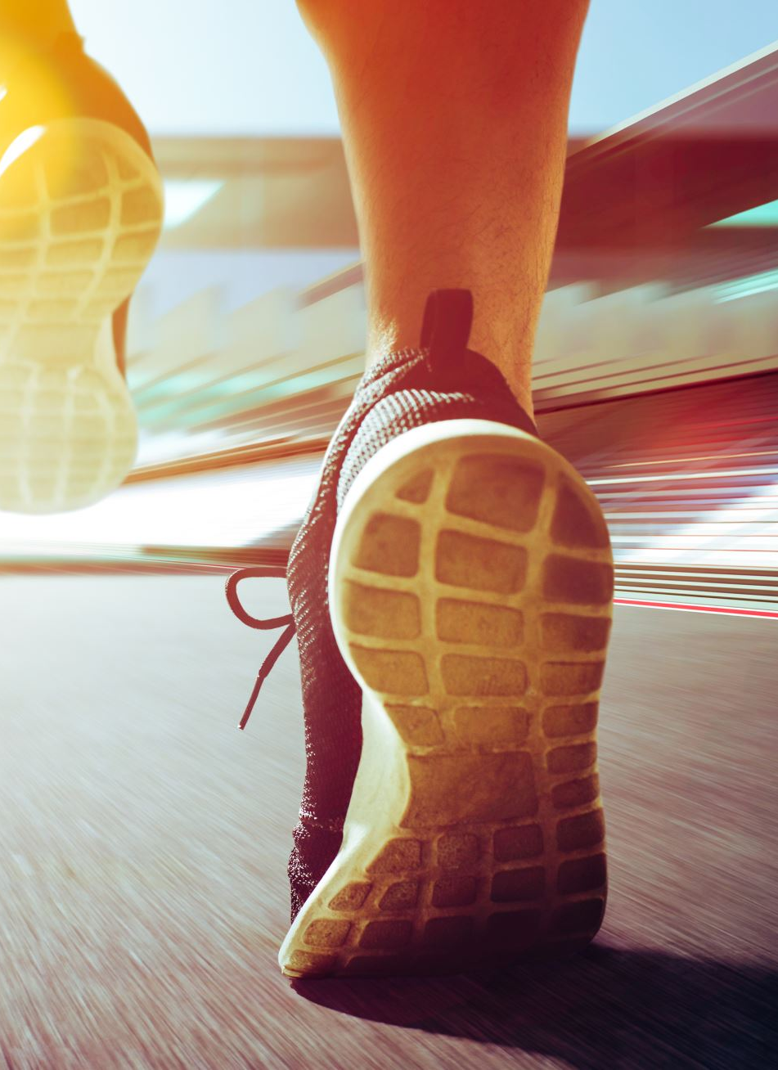
Background
Gait
Gait refers to the patterns of human walking, a key indicator of stability, balance, and overall mobility.
Why Analyze Gait?
Gait analysis provides crucial insights into an individual’s health, identifying potential issues such as balance impairments or mobility disorders.

Slide 3
Key Factors Impacting Stability
Physical activity-Engaging in physical activity at varying levels can enhance stability, improve coordination, and support overall mobility.
Gender differences-Men and women exhibit differences in stability, influenced by variations in biomechanics, muscle strength, and movement patterns.
Aging- as individuals age, stability often declines, leading to changes in walking patterns and gait characteristics, which can affect balance
BriefBEST- Stability test of the subjects.

Slide 4
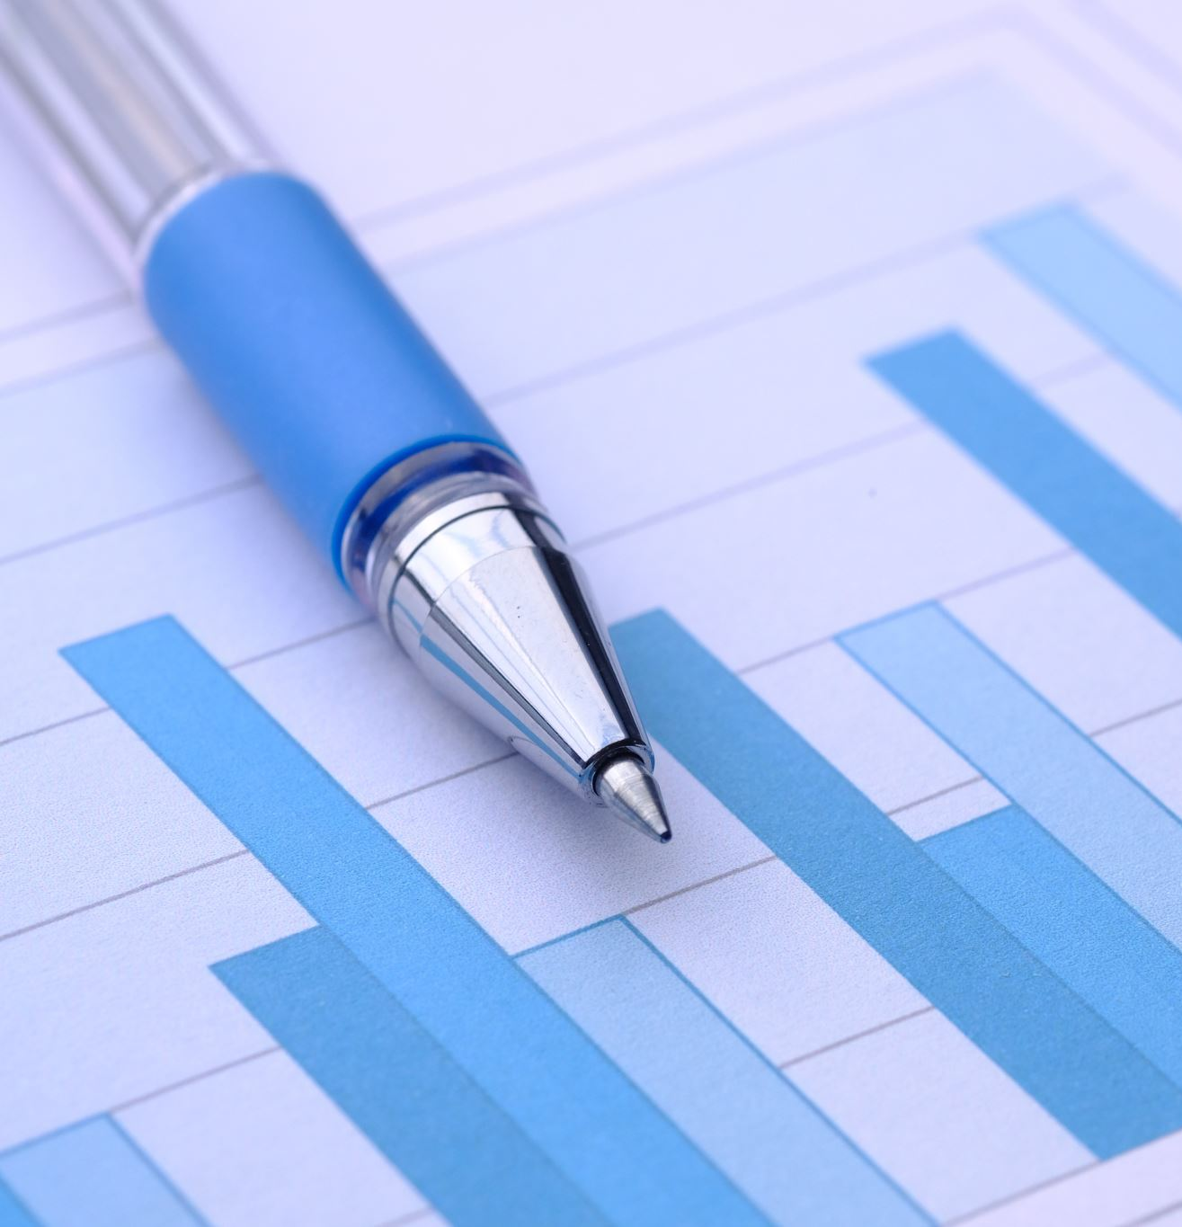
Introduction the problem
Gait detection data is presented in a large, unorganized Excel table.
The format makes it difficult to understand, process, and analyze.
Intuitive visualizations are needed to track stability and balance.
Challenge: Selecting the best graphical representation to highlight trends and anomalies.

Slide 5
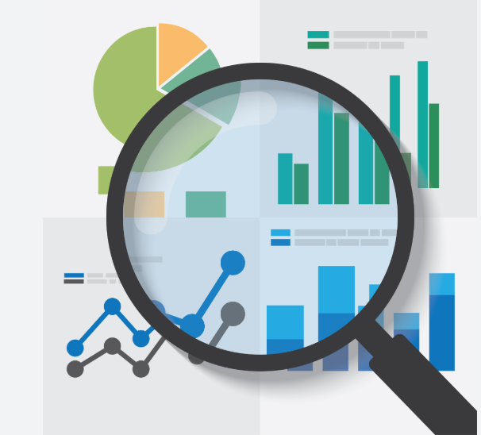
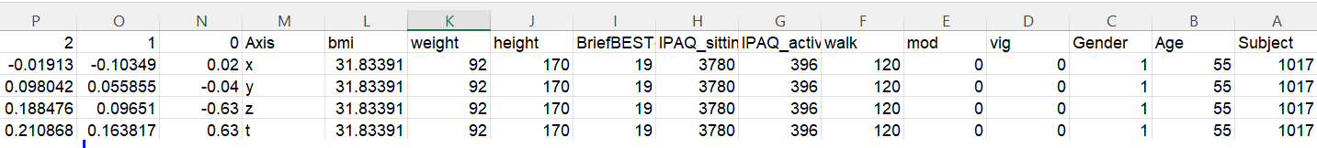
Data Review
Here, we present 4 rows for a single individual. Since we have data for 27 individuals (14 males,13 females), this results in a total of 108 rows.
There are 2,033 columns describing the characteristics of each individual, with a primary focus on their walking progression.

Slide 6
Challenges
Large and diverse dataset 📊
Changes over time ⏳
Difficulty in displaying data for 27 people simultaneously 👥
A single visualization is not enough - multiple graphs are needed 📈

Slide 7
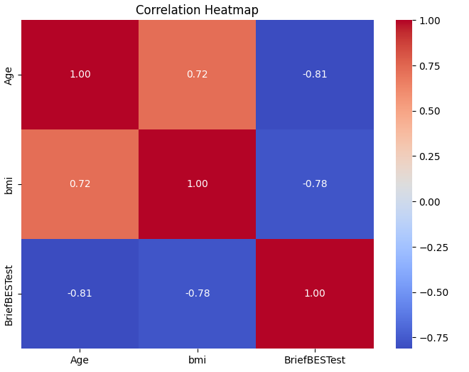
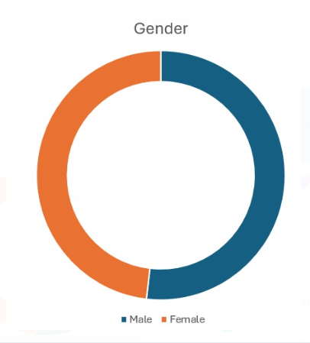
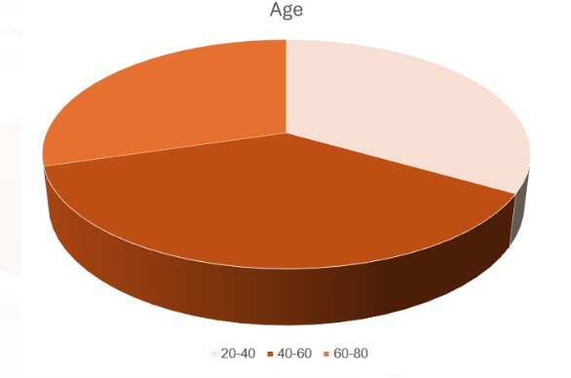
Data distribution
The chart displays the distribution of participants by gender, with 14 males and 13 females, providing a visual understanding of the data composition.
The chart shows the distribution of participants across three age groups: 20-40, 40-60, and 60-80
This graph visualizes the correlations between numerical variables such as Age, BMI, and BriefBESTest scores. A higher positive correlation (closer to 1) means the variables increase together, while a strong negative correlation (closer to -1) indicates an inverse relationship.

Slide 8
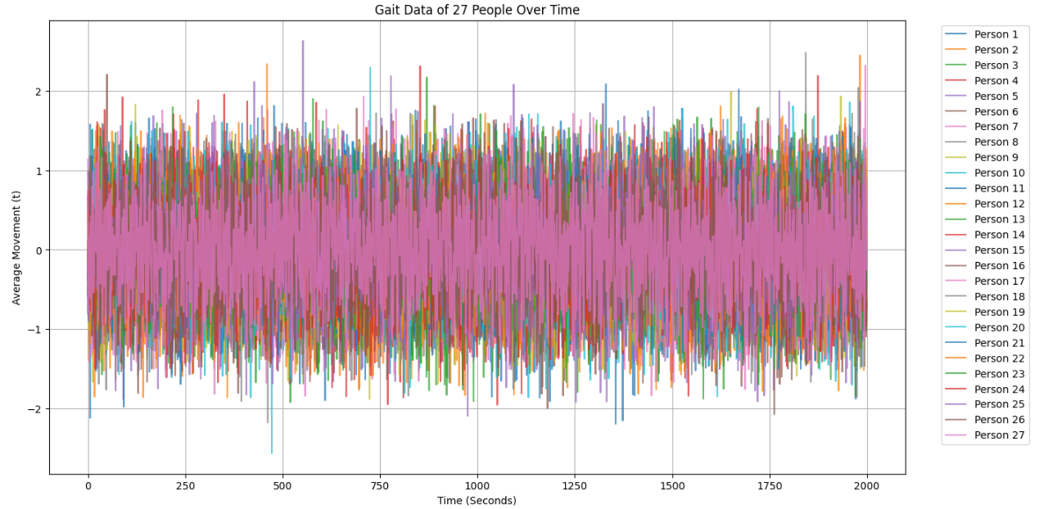
Illustrating the problem
This graph shows gait detection data from 27 participants over time but makes it hard to draw conclusions.

Slide 9
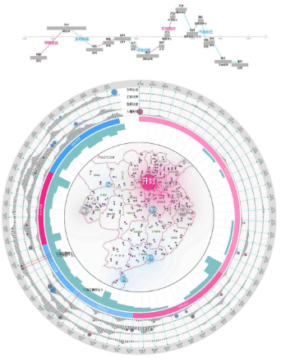
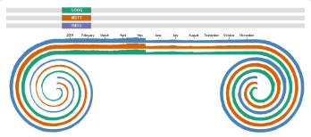
Time-Oriented Visualizations show data that evolves over time, helping to identify patterns and anomalies.
Circular data visualization
Advantages:
Clear visualization: Effectively shows changes over time.
Demonstrates progress: Good for illustrating changes over time.
Disadvantages:
Shows only one object at a time.
Difficult to compare multiple categories.
Difficult to understand precise relationships between data.
Linear Silhouette Graphs

Slide 10
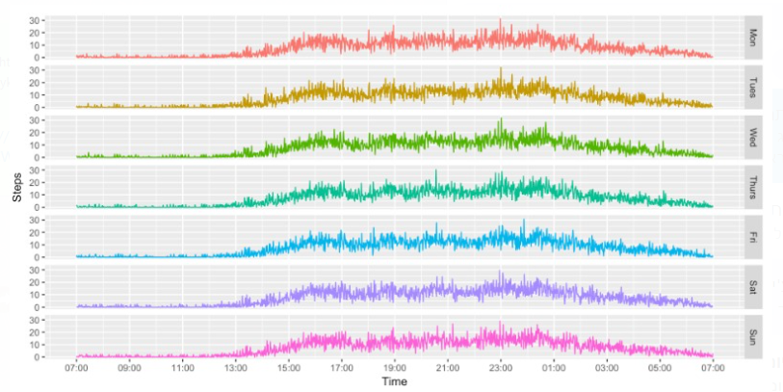
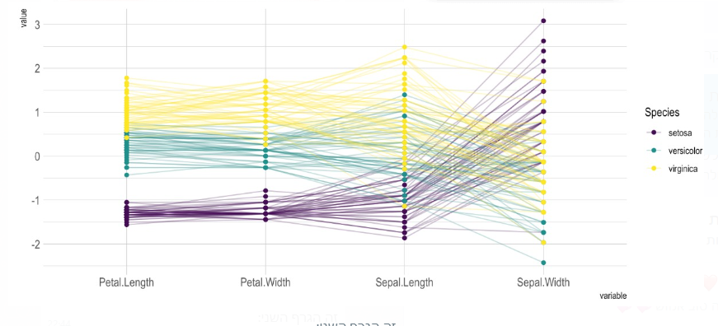
Small multiple
Parallel coordinates
Advantages -displays the data separately
Disadvantage- makes it difficult to compare other parameters
Advantage-allows comparing multiple data points at once.
Disadvantage-difficult to compare groups: Frequent line intersections make it challenging to spot differences

Slide 11
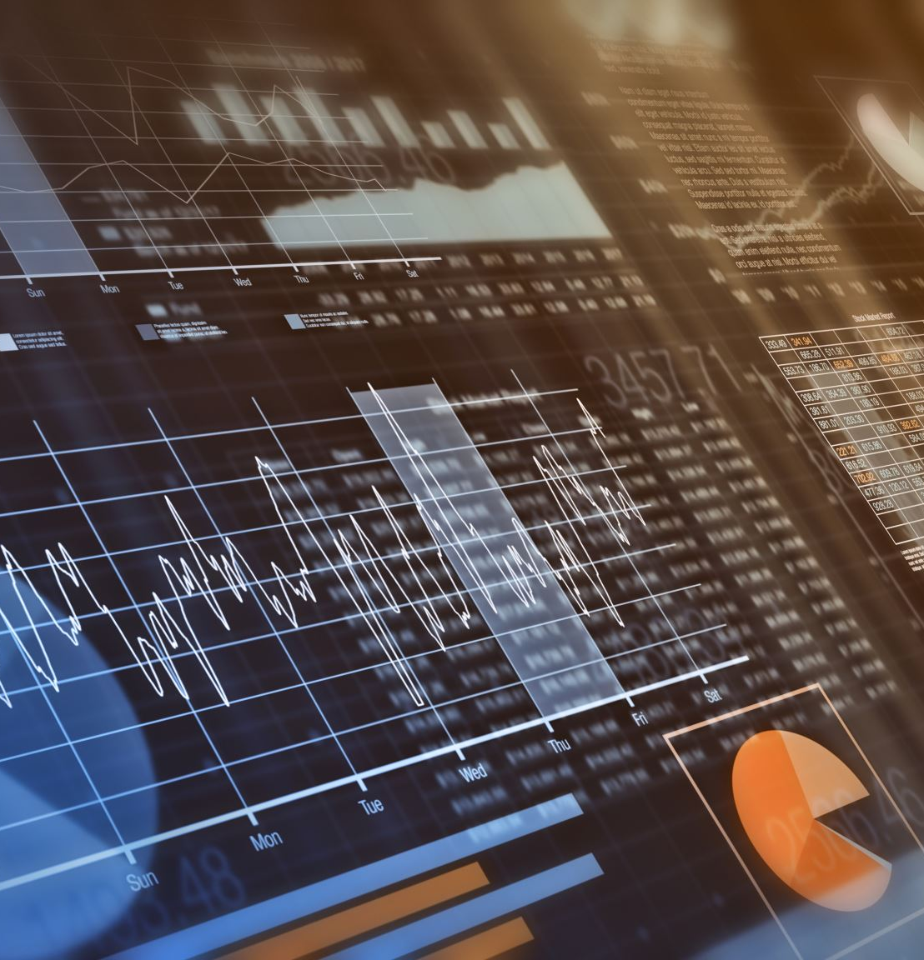
Conclusion from Data Review
Large data volume: Makes interpretation and analysis difficult.
Visualization through graphs: Helps in understanding patterns and trends.
Clearer insights: Facilitates better understanding of individuals' walking progression.

Slide 12
Project Objective
Present data through visualizations over time.
Show how individuals compare to others based on parameters like age or gender.
Visualize data by grouping individuals into relevant categories.
Present in a clear and understandable way.

Slide 13
work process
We examined several visualizations and concluded that using multiple graphs simultaneously is necessary for clear data presentation.
We will present the dashboard and, in the next phase, select the most effective visualizations based on our data.
we explored the tools D3 and Tableau, and later, we will determine which tool best serves our needs.

Slide 14
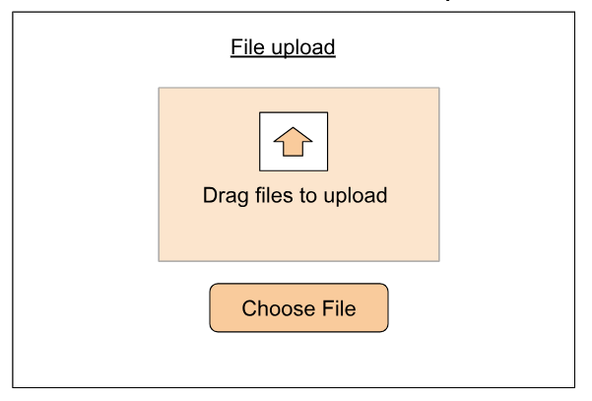
GaitStab- Gait stability Assessment

Slide 15
Description of the file size and its contents, how many columns and how many lines
By clicking on an age range, we get a graph that describes the BMI and the BriefBESTest for both men and women in the same age range. There are a different colors for men and women. You can click on the gender in the legend to move to the next graph.
A graph that depicts an age group, categorized by men and women, and shows the number of men and women in each age range. Each gender has a different color. The age ranges are buttons that can be clicked.
By clicking on women or men in the legend , you can get a graph that shows only one gender for comparison purposes It will be possible to click on several lines and thus compare people. The lines are also buttons
By clicking on one line, you can get a graph that shows the progress of walking for a single person over time.

Slide 16
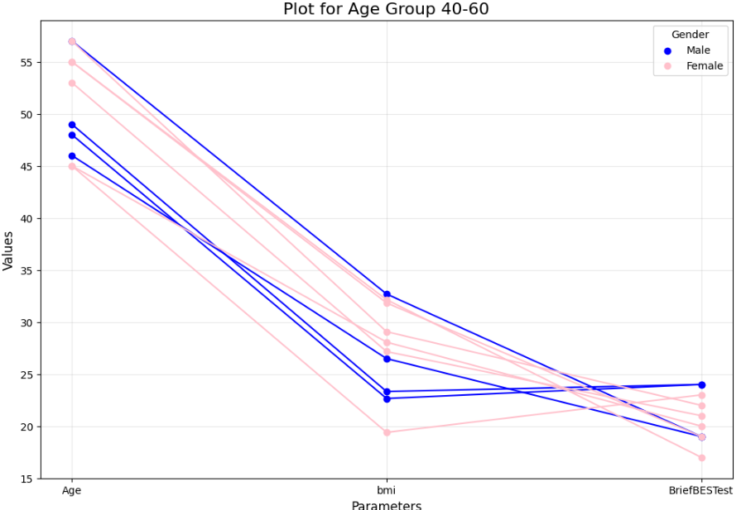
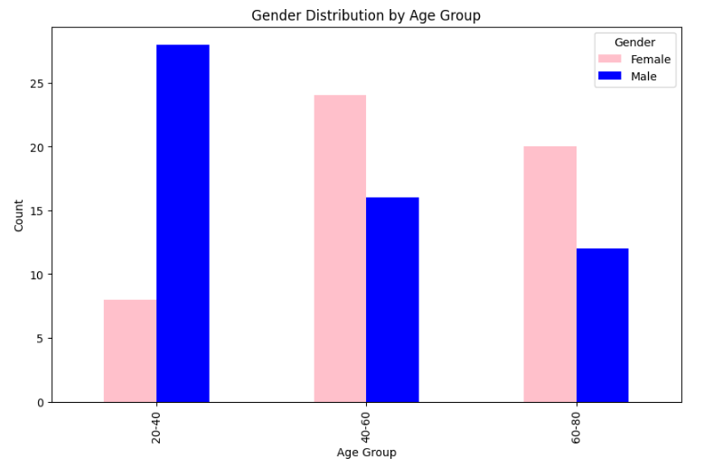
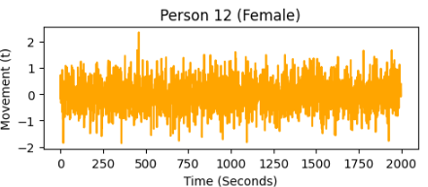

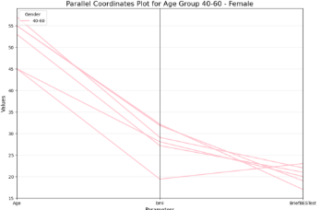
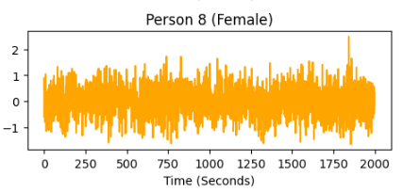
File size: 2599KB number of rows:108 number of columns: 2033
Gender
Female
Male
20-40
40-60
60-80
Gender
Female
Male

Slide 17
Evaluation
Presenting graphs to participants to assess clarity and understanding and evaluating how effectively the data supports interpreting walking patterns and stability.
We will conduct tests to ensure that the data is fully represented in the graphs.

Slide 18

Thanks for listening

